Slide 1

Feature Extraction and Price Prediction for Mobile Phones
Machine Learning for Smartphone Price Prediction
Project 4 - Industry Dataset Analysis
Presented By: Data Analytics
Bhawna Chouhan Internship Project NextHikes
July 2026

Slide 2
Project Overview
Project Workflow :
1. Data Collection
↓
2. Data Preprocessing
↓
3. Feature Engineering
↓
4. Exploratory Data Analysis
↓
5. Model Development
↓
6. Model Evaluation
↓
7. Feature Importance Analysis
↓
8. Business Recommendations
Project Summary
Predict smartphone prices using Machine Learning.
Identify the most influential smartphone features.
Compare Linear Regression and Random Forest models.
Provide business recommendations for pricing strategy.
Dataset Overview
Dataset Size : 531 Smartphone Records
Target Variable : Prize
Input Features : 14 Selected Features
Models Used : Linear Regression &
Random Forest Regression

Slide 3
Business Problem & Project Objectives
Business Problem
Smartphone prices depend on multiple hardware and software features.
Manually estimating the correct price is difficult because many features interact simultaneously.
Data-driven price prediction improves pricing decisions and market competitiveness.
Project Objectives
Predict smartphone prices using Machine Learning.
Identify the most influential features.
Compare Linear Regression and Random Forest.
Evaluate model performance.
Generate business recommendations.
Expected Business Impact
Improve pricing decisions.
Support product positioning.
Identify high-value features.
Enable better future pricing.

Slide 4
Dataset Understanding
Feature Categories
Device Information
Brand
Model
Colour
Hardware Specifications
RAM
Memory
Processor
Battery Capacity
Mobile Height
Camera Features
Front Camera
Rear Camera
Total Camera MP
AI Lens
Engineered Features
Battery Category
Colour Category
Dataset Summary
Dataset Name : Mobile Phones Dataset
Total Records : 531 Smartphones
Input Features : 14 Selected Features
Target Variable : Prize
Machine Learning Task : Regression
Dataset Purpose : Build a machine learning model to
predict smartphone prices.
Prediction Target
Target Variable : Prize
The model learns the relationship between smartphone
specifications and price to predict prices for new smartphones.

Slide 5
Data Preprocessing & Feature Engineering
Data Preprocessing
Removed duplicate records.
Checked missing values.
Encoded categorical features.
Prepared data for modeling.
Feature Engineering
Created Battery Category.
Created Color Category.
Created Total Camera MP.
Final Dataset
531 Smartphone Records
14 Input Features
Target: Prize (₹)
Preprocessing Workflow :
Raw Dataset
↓
Duplicate Check
↓
Missing Value Check
↓
Categorical Encoding
↓
Feature Engineering
↓
Final Dataset

Slide 6
Exploratory Data Analysis (EDA)
Purpose of EDA
Understand smartphone data characteristics.
Explore feature distributions.
Identify relationships among variables.
Detect outliers and unusual observations.
Prepare insights for machine learning.
Key Outcome
EDA revealed important patterns in smartphone specifications and helped identify the most influential features for accurate price prediction.
Analysis Performed
Distribution Analysis
Outlier Detection
Correlation Analysis
Feature Relationship Analysis

Slide 7
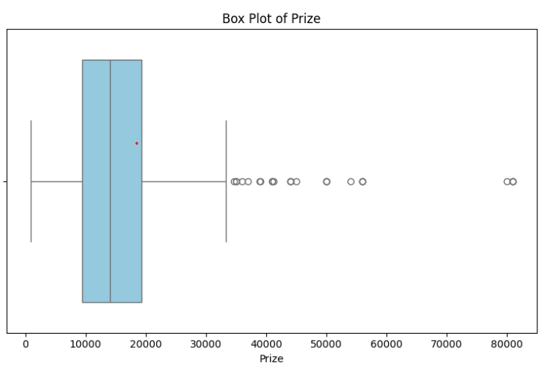
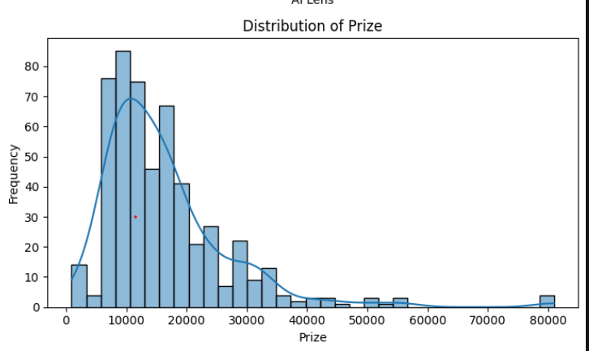
Univariate Analysis
Key Observations
Most smartphone prices are concentrated in the lower price range.
A few premium smartphones appear as outliers.
Price distribution is positively skewed.
These insights guided model development.

Slide 8
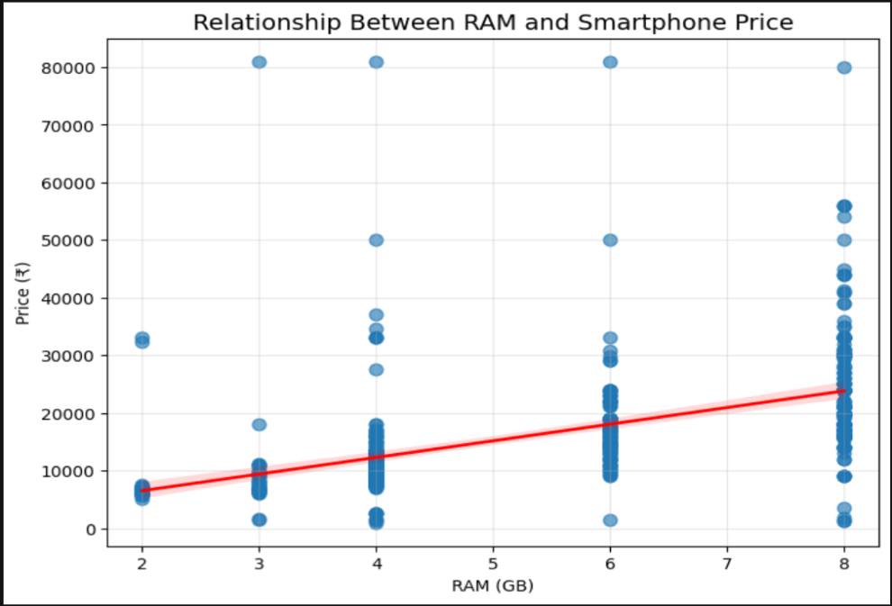
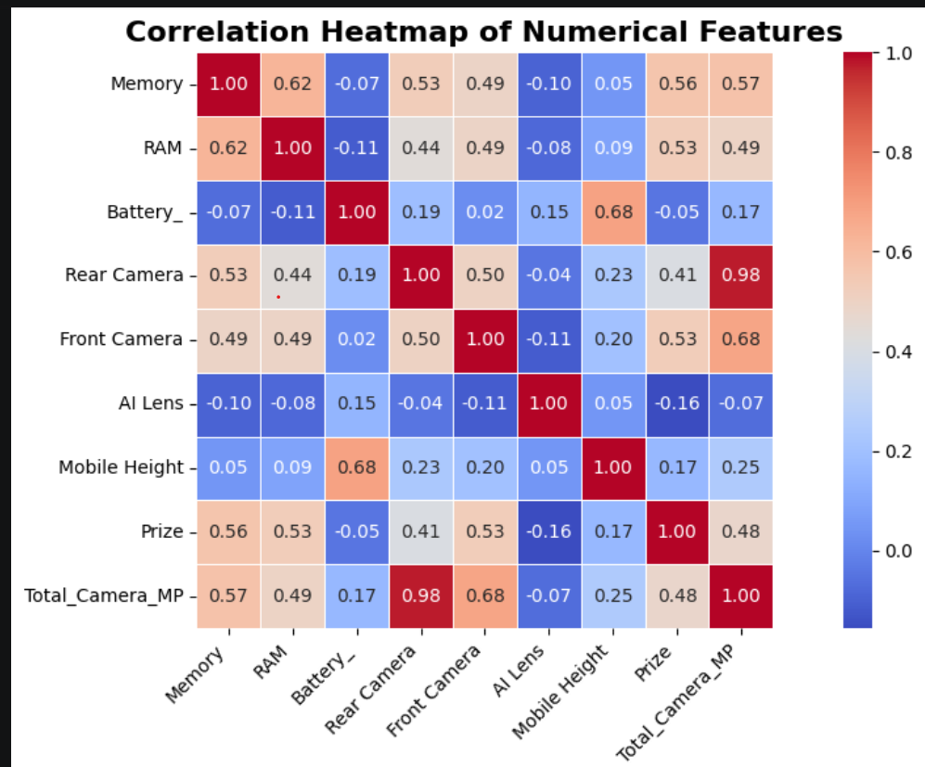
Bivariate Analysis & Correlation
Objective
Analyze relationships between smartphone features and price.
Identify the features most strongly associated with pricing.
Key Observations
Higher RAM and Memory are generally associated with higher smartphone prices.
Camera specifications show a positive relationship with price.
The correlation heatmap identifies the most influential features used for model development.

Slide 9
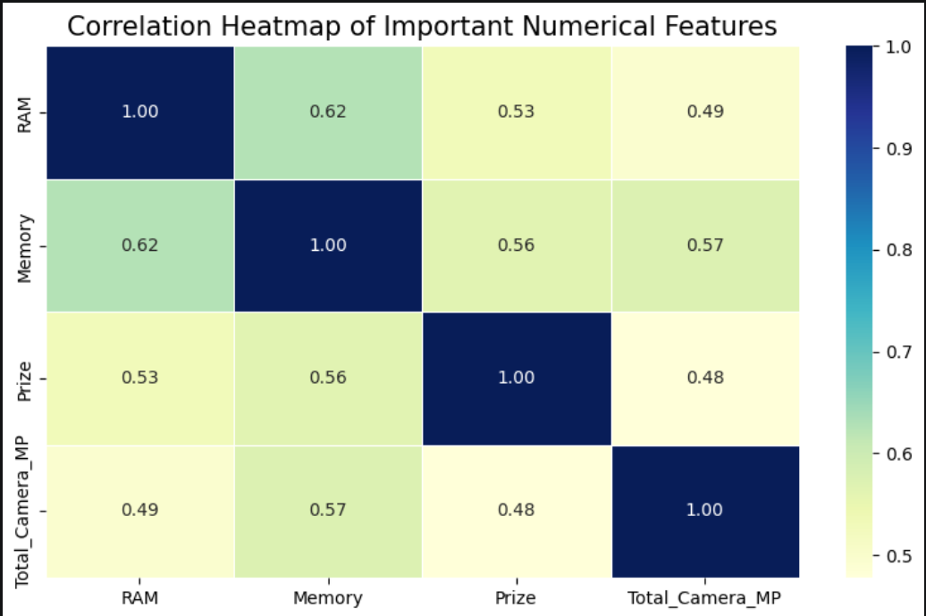
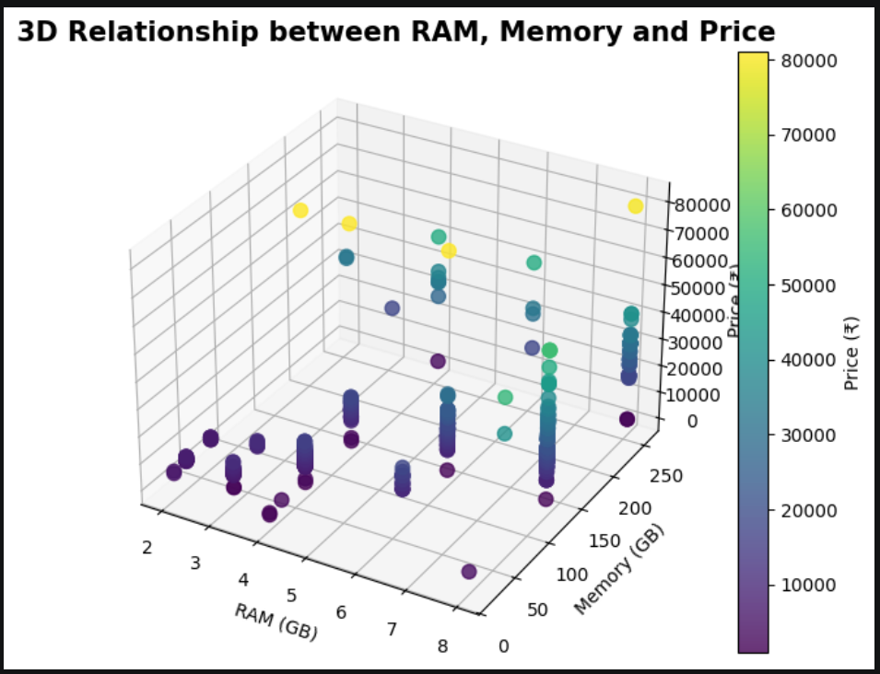
Multivariate Analysis
Objective
Analyze the combined effect of multiple features on smartphone price.
Key Observations
Higher RAM and Memory are generally associated with higher prices.
Multiple features together improve price prediction.
Multivariate analysis supports feature selection for machine learning

Slide 10
Machine Learning Model Development
Model Building Process
Split the dataset into 80% Training and 20% Testing.
Trained Linear Regression and Random Forest Regression models.
Learned pricing patterns from the training dataset.
Evaluated both models using unseen test data to measure
prediction accuracy.
Models Implemented
Linear Regression :
Baseline model for price prediction.
Random Forest Regression :
Ensemble model that captures complex, non-linear relationships.
Workflow :
Prepared Dataset
↓
Train-Test Split
(80% / 20%)
↓
Model Training
↓
Price Prediction
↓
Model Evaluation

Slide 11
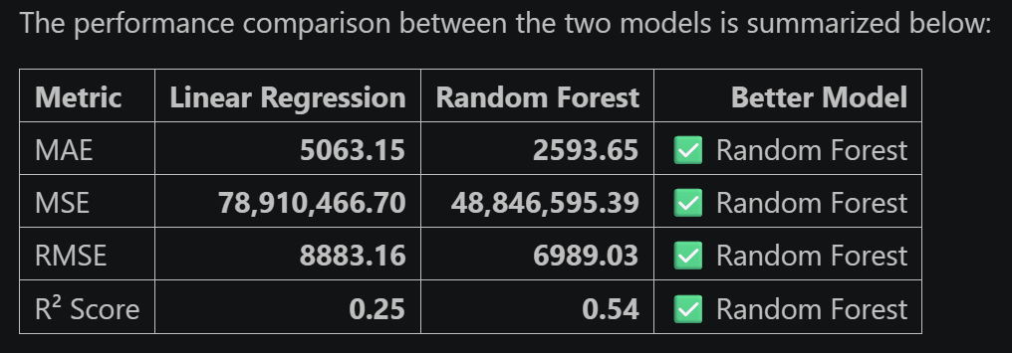
Model Evaluation & Performance Comparison
Key Findings
Random Forest outperformed Linear Regression across all evaluation metrics.
MAE, MSE, and RMSE were significantly lower, indicating more accurate price predictions.
Random Forest improved the R² Score from 0.25 (Linear Regression) to 0.54 while reducing MAE, MSE, and RMSE, demonstrating better predictive performance.
Random Forest captured complex, non-linear relationships between smartphone features more effectively.
*
Conclusion
Random Forest Regression was selected as the final model because it achieved the highest prediction accuracy and the lowest prediction error among all evaluated models.
Best Model Selected Random Forest Regression

Slide 12
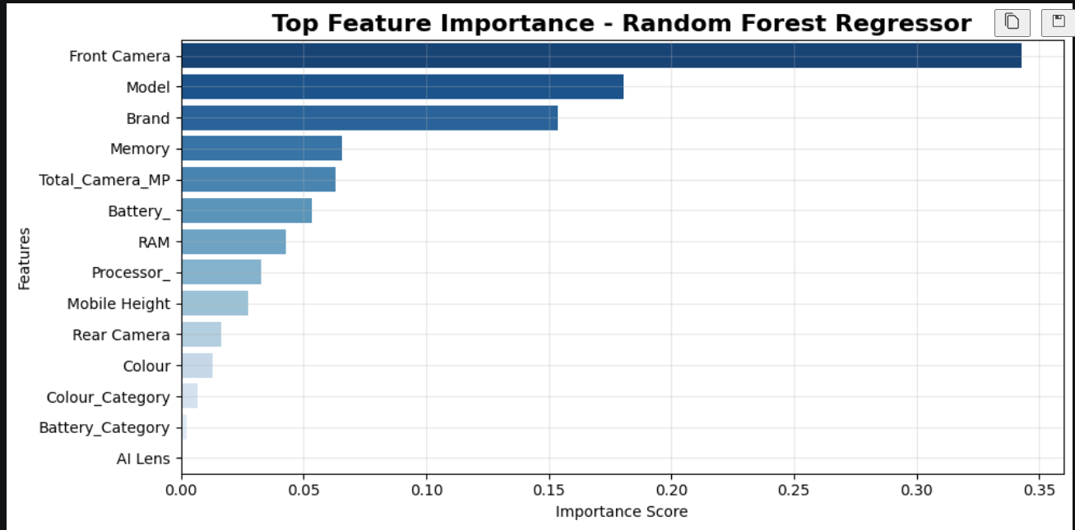
Feature Importance Analysis (Random Forest)
Objective
Identify the most influential features affecting smartphone prices.
Key Findings
Front Camera was the most influential feature.
Model and Brand also had a significant impact.
Memory, Total Camera MP, Battery, and RAM contributed moderately.
AI Lens and Battery Category had minimal influence.
Business Insight
Premium smartphone prices are mainly driven by camera quality, brand reputation, and hardware specifications.

Slide 13
Business Recommendations
Business Recommendations
Improve camera quality and memory for premium smartphones.
Optimize RAM and battery capacity to increase product value.
Use machine learning to support pricing decisions.
Update the model regularly with new smartphone data.
Business Benefits
✔ More accurate pricing
✔ Better product positioning
✔ Data-driven decisions
✔ Improved customer value
Workflow :
Feature Analysis
↓
Price Prediction
↓
Business Insights
↓
Pricing Strategy
↓
Better Decision Making

Slide 14
Conclusion
Project Summary
Successfully developed a smartphone price prediction model.
Performed EDA, feature engineering, and model evaluation.
Compared Linear Regression and Random Forest Regression.
Key Findings
Random Forest achieved the best prediction performance.
Camera, Brand, Memory, and RAM were the most influential features.
Machine learning can support accurate smartphone pricing.
Future Scope
Increase the dataset with newer smartphone models.
Test advanced machine learning algorithms (e.g., XGBoost).
Develop a real-time price prediction web application.
Final Model Selected: Random Forest Regression ✅

Slide 15
THANK YOU!
Bhawna Chouhan
Data Analytics Internship Project
NextHikes

